Slide 1
Ecological Revitalization at Mining Sites
Michele Mahoney
Environmental Scientist
EPA TIFSD

Slide 2
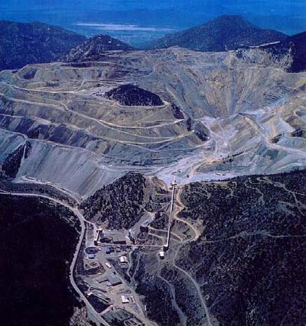
Common Challenges at Mining Sites
Remote locations
Mixed ownership
Complex contaminant location and transport
Multiple mines within a watershed

Slide 3
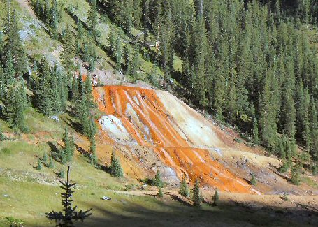
Common Challenges Cont.
Huge volumes of waste
Regulatory challenges
Acid mine drainage
Cleanup standards

Slide 4
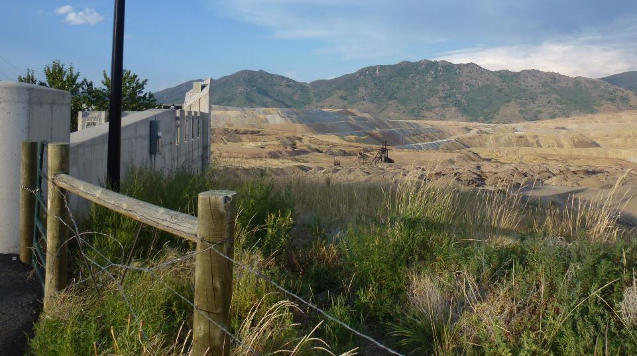
Considering Green Remediation Techniques
Consider more sustainable and greener cleanup options, such as:
1. Revegetation with native plants
2. Soil amendments

Slide 5
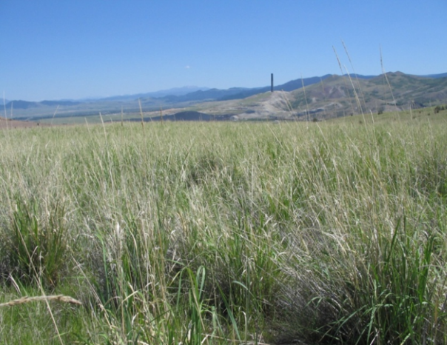
Using Soil Amendments
Why use Soil Amendments?
Soil amendments can:
Reduce contaminant exposure, bioavailability and phytoavailability
Improve soil health & ecosystem function
What kind of mining sites are good candidates for soil amendments?
Hard rock mining sites
Coal mining sites
Smelting and refining sites

Slide 6
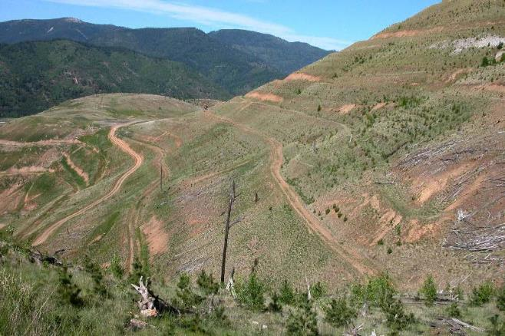
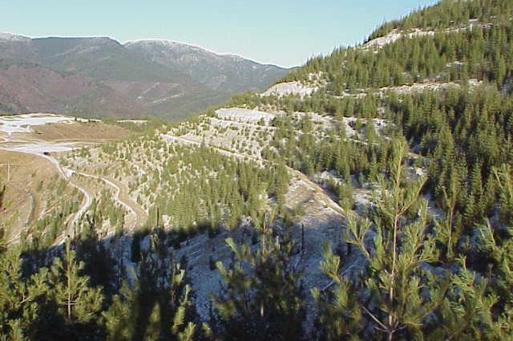
Restoring Hillsides at the Bunker Hill Site, Coeur d’Alene, Idaho
1993
2003
2014

Slide 7
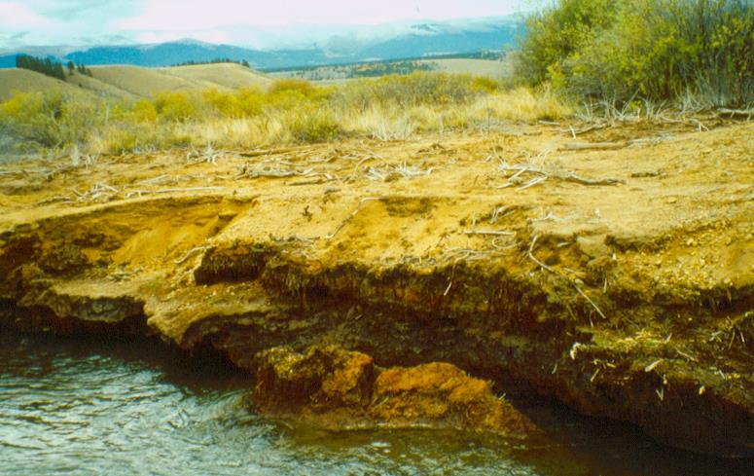
Revitalizing Landscapes at California Gulch, Lake County and City of Leadville, Colorado
1996
2009

Slide 8
Resources
EPA
https://clu-in.org/greenremediation/docs/GR_factsheet_miningsites.pdf
https://www.epa.gov/sites/production/files/2015-12/documents/mining_framework20030807signed.pdf
www.cluin.org/ecotools
www.cluin.org/mining
Interstate Technology Regulatory Council (ITRC)
http://www.itrcweb.org/Documents/MiningWhitePaper_2008.pdf
http://www.itrcweb.org/miningwaste-guidance/reg_issues.htm
BLM/Forest Service
http://www.blm.gov/style/medialib/blm/wo/MINERALS__REALTY__AND_RESOURCE_PROTECTION_/aml.Par.86533.File.dat/Final%20AML%20Report.pdf

Slide 9
For More Information, Contact
Michele Mahoney
Environmental Scientist
EPA TIFSD
Phone: 703-603-9057
Email: mahoney.michele@epa.gov

